Slide 1
Chapter 33
Estimation for Software Projects
Slide Set to accompany
Software Engineering: A Practitioner’s Approach, 7/e
by Roger S. Pressman
Slides copyright © 1996, 2001, 2005, 2009 by Roger S. Pressman
For non-profit educational use only
May be reproduced ONLY for student use at the university level when used in conjunction with Software Engineering: A Practitioner's Approach, 7/e. Any other reproduction or use is prohibited without the express written permission of the author.
All copyright information MUST appear if these slides are posted on a website for student use.
These slides are designed to accompany Software Engineering: A Practitioner’s Approach, 7/e (McGraw-Hill 2009). Slides copyright 2009 by Roger Pressman.

Slide 2
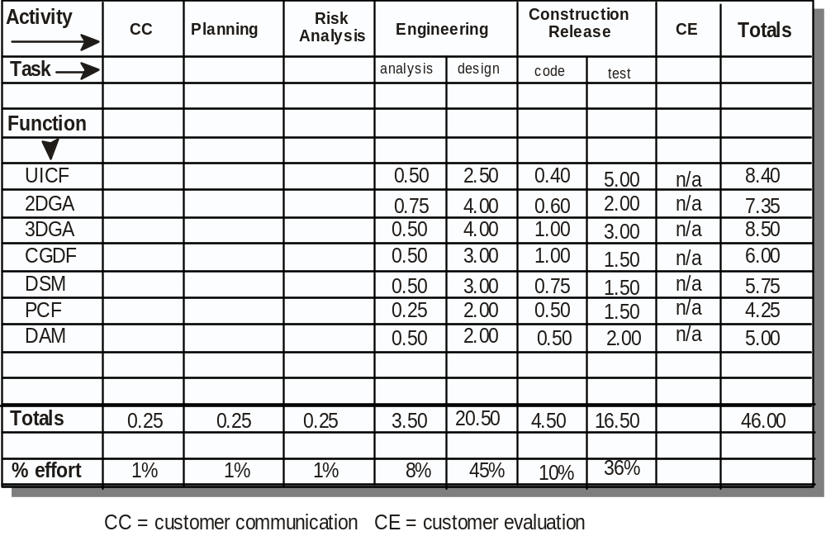
Process-Based Estimation Example I

Slide 3
Process-Based Estimation Example II
Let:
Based on an average burdened labor rate = $8,000 pm
The estimated effort (EE) = 46 person-months
So
The total estimated project cost = LR *EE
= 8,000 * 46 = $368,000

Slide 4
Estimation with Use-Cases
Use cases are described using many different formats and styles and represent an external view (the user’s view) of the software (many different level)
Use cases do not address the complexity of the functions and features that are described, and they can describe complex behavior (e.g., interactions)
Calculate use case point (UCP)
  = (UUCW + UAW) x TCF x ECF
  unadjusted use case weight (UUCW)
  unadjusted actor weight (UAW)
  technical complexity factors (TCF)
  environment complexity factors (ECFs)

Slide 5
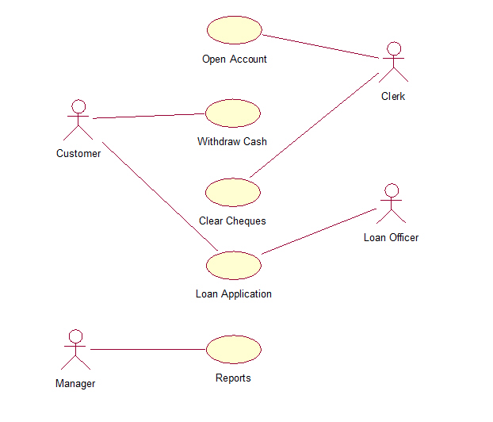

Slide 6
Example of Use-Cases Point
-Software is composed of three subsystem groups:
  user interface subsystem
  16 complex use cases describe the user interface subsystem
  Engineering subsystem group
  The engineering subsystem group is described by 14 average use cases and 8 simple use cases
  Infrastructure subsystem group.
  The infrastructure subsystem is described with 10 simple use cases.
- Analysis of the use cases indicates that
  There are 8 simple actors, 12 average actors, and 4 complex actors.

Slide 7
Example of Use-Cases Point
Different multiplier value of use case complexity
Different multiplier value of actor complexity
Level | Value
Simple | 5
Average | 10
Complex | 15
Level | Value
Simple | 1
Average | 2
Complex | 3

Slide 8
Example of Use-Cases Point
Answers
  = (UUCW + UAW) x TCF x ECF
UUCW = (16 use cases x 15) + [(14 use cases x 10) + (8 use cases x 5)] + (10 use cases x 5) = 470.
UAW = (8 actors x 1) + (12 actors x 2) + (4 actors x 3) = 44
(UUCW + UAW) = 470 + 44 = 514

Slide 9
Example of Use-Cases Point
  After evaluation of the technical complexity factors (TCF)
TCF= 1.04
  The evaluation of the environment complexity factors (ECFs)
ECF = 0.96
So
UCP = 514 x 1.04 x 0.96 = 513

Slide 10
Example of Use-Cases Point
Let
  The development group has produced 85 LOC per UCP.
  Using 620 loc/pm as the average productivity (AOP)
  Labour rate of $8,000/month (LR)
So
The overall size of the project, Size_{P} = UCP * 85 = 43,605 LOC
The cost per line of code = (LR/AOP) = $12.9
The total estimated project cost (Cost_{LOC}*size_{p}) = $562,504.5
The estimated effort EE= (Size_{p}/AOP) = 70.3=70 person-months.

Slide 11
Empirical Estimation Models
An estimation model for computer software uses empirically derived formulas to predict effort as a function of LOC or FP.
The resultant values for LOC or FP are plugged into the estimation model.
No estimation model is appropriate for all classes of software and in all development environments.

Slide 12
Empirical Estimation Models
An estimation model should be calibrated to reflect local conditions.
  The model should be tested by applying data collected from past projects’
  Plugging the data into the model,
  Then comparing actual to predicted results.
  If agreement is poor, the model must be tuned and retested before it can be used.

Slide 13
COCOMO-II
COCOMO (COnstructive COst MOdel) is actually a hierarchy of estimation models that address the following areas:
Application composition model. Used during the early stages of software engineering, when prototyping of user interfaces, consideration of software and system interaction, assessment of performance, and evaluation of technology maturity are paramount.
Early design stage model. Used once requirements have been stabilized and basic software architecture has been established.
Post-architecture-stage model. Used during the construction of the software.

Slide 14
The Software Equation
A dynamic multivariable model
E = [LOC x B^{0.333}/P]³ x (1/t⁴)
E = effort in person-months or person-years
B = “special skills factor”
-Increases slowly as the need for integration, testing, QA, documentation, and management skills grow
P = “productivity parameter”
The extent to which good SE practices are used, the level of programming language used, the state of the software environment, the skills and experience of the software team and the complexity of the application
t = project duration in months or years

Slide 15
Estimation for Agile Projects
Each user scenario is considered separately for estimation purposes.
The scenario is decomposed into the set of software engineering tasks that will be required to develop it.
Each task is estimated separately.
Note: estimation can be based on historical data, an empirical model, or “experience.”
  The ‘volume’ of the scenario can be estimated in LOC, FP.

Slide 16
The Make-Buy Decision
Software engineering managers are faced with a make/buy decision
  Software may be purchased (or licensed) off-the-shelf
  “Full-experience” or “partial-experience” software components may be acquired and then modified and integrated to meet specific need
  Software may be custom built by an outside contractor to meet the purchaser’s specifications.

Slide 17
The Make-Buy Decision
the final analysis, the make/buy decision is made based on the following conditions:
  Will the delivery date of the software product be sooner than that for internally developed software?
  Will the cost of acquisition plus the cost of customization be less than the cost of developing the software internally?
  Will the cost of outside support (e.g., a maintenance contract) be less than the cost of internal support?

Slide 18
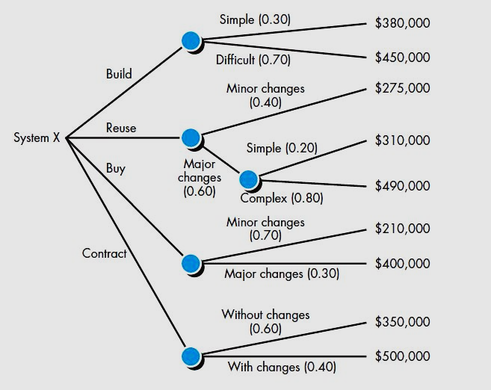
Decision tree to support the make-buy decision

Slide 19
Decision tree to support the make-buy decision
expected cost =
(path probability) x (estimated path cost)
i
i
  where i is the decision tree path
  Expected cost build = 0.30 ($380,000) + 0.70 ($450,000) = $429,000
  Expected cost reuse = 0.40 ($275K) + 0.60 [0.20 ($310K) + 0.80 ($490K)] =$384K
  Expected cost buy = 0.70 ($210K) + 0.30 ($400K) = $267K
  Expected cost contract = 0.60 ($350K) + 0.40 ($500K) = $410K

